Slide 1
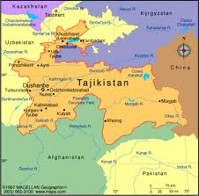
Tajikistan (Low Income)
Presented by: Ashley Baugh

Slide 2
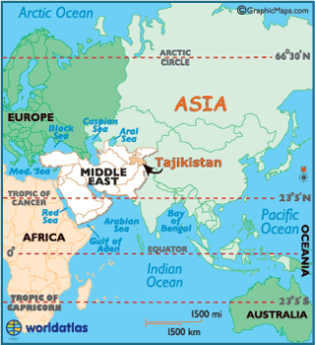
Tajikistan: basic facts
Islamic Country
Between Turkmenistan and China
North East of Afghanistan and just north of Pakistan
39’ N, 71’ E
Slightly smaller than Wisconsin
Population: 7,768,385

Slide 3
Basic Facts & Vital Statistics
Population growth: 1.823%
Urban population: 26%
Urbanization: 2.2% annual rate of change
Birth Rate: 25.93/ 1,000 population
Death Rate: 6.49/1,000 population
Life Expectancy at Birth: 66.38 years
Male: 63.3
Female: 69.61

Slide 4
Tajikistan: Background Information
Only been an independent country since 1991 formerly part of USSR)
Civil War 1992-1997
Poorest of the Central Asian Republic countries
Receives aid from Saudi Arabia and Russia
War in Afghanistan
Economic growth and development
Security assistance

Slide 5
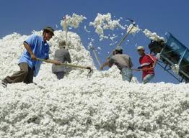
The land
Landlocked: only 99.7 c.u. km of renewable water sources (less than 2% of the area)
6.52% arable land (cotton is main crop)
Natural hazards: earthquakes, floods, and harsh winters
Natural Resources:
Hydropower
Some petroleum
Uranium, mercury, brown coal, lead, zinc, antimony, tungsten, silver, gold

Slide 6
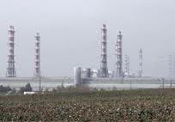
Environmental Health Hazards
Sanitation
Soil salinity
Industrial pollution
Excessive pesticide use

Slide 7
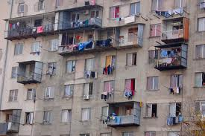
Tajikistan: Economics
Population below poverty line: 46.7%
GDP: $7,263 billion
GDP growth: 6.8%
GDP per capita: $2,200
GDP by sector
Agricultrure:19.3%
Industry:20.1%
Services: 60.5%
Over 1million of Tajiks work abroad and send money home
73% of health expenditures come from private/individual sources

Slide 8
Key Health Indicators
Total Fertility Rate: 2.85 children born/woman (2012)
Infant mortality Rate: 37.33deaths/1,000 live births (2012)
Maternal Mortality Rate: 65 deaths/100,000 live births (2010)
Under 5 Mortality Rate: 67 deaths/1,000 live births (2005)
Under 5 & underweight: 14.9% (2007)

Slide 9
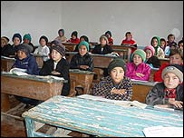
Key Health Indicators
Health Expenditures: 5.3% of GDP (2009)
Physician density: 2.013 Dr.s/1,000 population (2006)
School life expectancy (2008)
Male: 12 years
Female 10years

Slide 10
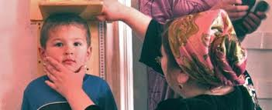
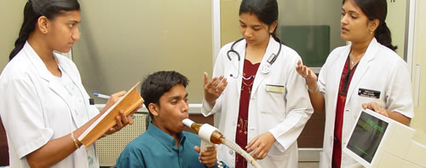
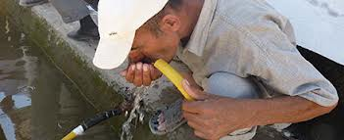
Current Major Health Issues
Unintentional Injuries
Non-Communicable:
Malnutrition (33% stunting)
Cardiovascular
Neuropsychiatric
Communicable/Infectious:
Bacterial diarrhea
Hepatitis A
Typhoid Fever
Malaria
TB

Slide 11
More Major Health Issues
~ 200,000 children aged 5-14 are engaged in some form of child labor
Tajikistan is in a position to achieve Millennium Goal 4 (Reduce child Mortality)
Over 40% of infant deaths occur in 1st week
Postnatal concerns to be addressed:
malnutrition
diarrheal diseases
acute respiratory infections

Slide 12
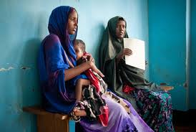
Burden of Disease DALYs-disability adjusted life years /1000 cap
Total DALYs: 67/1000 cap
Deaths 14, 500, 27% of total burden
Water (sanitation/diarrhea) 26
Indoor pollution (Solid Fuel Use) 17
Respiratory diseases 15
Cardiovascular 3.3
Unintentional injuries 4.3

Slide 13
References

