Slide 1
COPD
Chronic Obstructive Pulmonary Disease
Ashley Baugh- Epi455(Fall 2012)

Slide 2
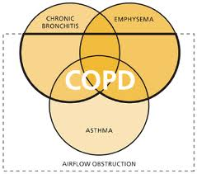
What is COPD?
Chronic Obstructive Pulmonary Disease is:
Chronic Obstructive Pulmonary Disease, or COPD, refers to a group of diseases that cause airflow blockage and breathing-related problems.
Umbrella term, includes: chronic bronchitis, emphysema, and/or at times asthma
Progressive (gets worse over time)
Cannot be passed from person to
person
Mild to severe (debilitating)
can be fatal

Slide 3
What is COPD?
In COPD, LESS air flows in/out of airways because:
Emphysema:
airways and sacs lose elasticity
Walls between sacs are destroyed (lose shape)
Bronchitis:
Walls of airways become thick and inflamed
Airways make more mucus than usual, which can clog them

Slide 4
Emphysema

Slide 5
Chronic Bronchitis

Slide 6
Asthma

Slide 7
COPD Symptoms
On-going coughing that produces large amounts of mucus
Wheezing
Shortness of breath-usually beginning with physical activity
Chest tightness
May get colds/flu/respiratory infections often
*Severe COPD may cause swelling of ankles/feet/legs, weight loss, low muscle endurance

Slide 8
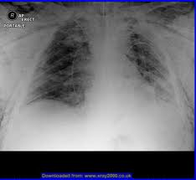
Diagnosis
Spirometry- a device use to measure how deeply a person can breathe, and how fast air can move into and out of the lungs.
Arterial gas blood test- blood is drawn and tested to measure the amount of oxygen in the arteries
Lung XRay or CT scan
Physical Examination
*Often under diagnosed or misdiagnosed
(often mistaken for asthma)

Slide 9
Diagnosis Study
Making the Right Diagnosis: The need for Spirometry Program (and Data Collection evaluations/audit-3mo. Pre and post)
Early Diagnosis
Better management of COPD patients
Address Gaps in treatment
Funded by educational grants
Analysis:
Importance of using spirometry to distinguish COPD from Asthma and recognizing that it is crucial for diagnosing and properly treating patients
Need more education-medical professionals in interpretation of spirometry results
Hands on trainings were added after post evaluation
Despite the gaps found, the study and program were considered a success

Slide 10
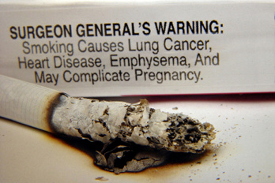
Statistics/Data
RISK FACTORS/EXPOSURES:
#1: Smoking tobacco (cigarettes, cigars, pipes, etc.. Especially when inhaled)
Second hand smoke
Air pollution/chemicals
Workplace and environmental dust
Can develop from asthma (not as common)
Family history of smokers
Genetic condition: AAT deficiency
History of lung/respiratory infections
Most commonly diagnosed in longtime smokers over 40 years old
**With the exception of genetic predisposition, COPD cannot be passed from person to person

Slide 11
Incidence/Prevalence
Currently 65 million in world have moderate to severe COPD
COPD currently affects 13million American Adults
An additional 12 million are likely have COPD and don't even know it (highly under diagnosed)
Healthcare costs are about $6,000 annually per COPD patient
Global prevalence is between 4-10%.
Estimated to be 3rd leading cause of death worldwide by 2030

Slide 12
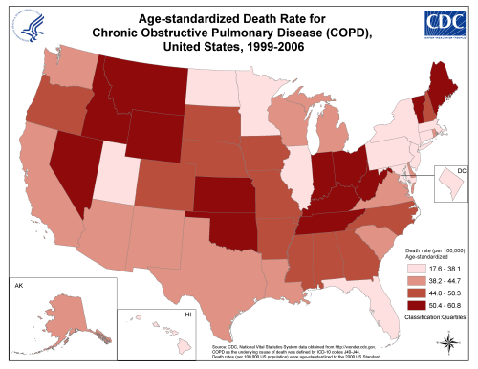
Prevalence Rates in US
\

Slide 13
Morbidity/Mortality
Did You Know?
COPD is the 3rd cause of death in the United States and causes serious, long-term disability
COPD kills more than 120,000 Americans each year. That's one death every 4 minutes
Smoking is estimated to be responsible for about 75% of COPD related deaths
90% of COPD deaths occur in low/middle income countries, while most of the recorded research is done in/on high income countries
**Due to:
*poor air quality
*less education/knowledge of the dangers of tobacco use
*less access to treatment

Slide 14
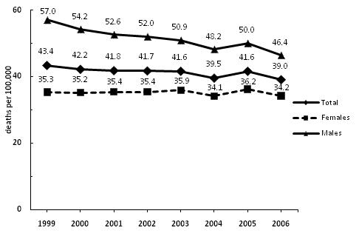
COPD Death Rates-U.S (age Standardized)

Slide 15
Mortality

Slide 16
COPD in non-smokers
COPD is most commonly caused by smoke/ prolonged smoked tobacco use, however, there are many cases of non-smoker COPD.
A study showed that if they had limited their COPD research only to non-smokers, their diagnosis rate from the 1960 participants would have been reduced by 26%.
*A COMMON MISTAKE AND HUGE UNDERDIAGNOSIS
Two most common non-smoker causes:
Occupational
Genetic disorder- AAT (Alpha-1 antitrypsin) deficiency
protein made in liver
Lack of AAT in lungs can cause COPD
Usually inherited

Slide 17
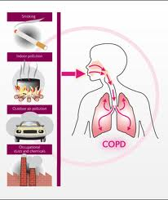
Prevention
Smoking cessation-programs, counseling, tools/aids provided OTC, and/or by employer, or health care provider
Reduce exposure to second hand smoke-choose non-smoking public venues, and do not allow others to smoke in your home
Length of time smoking is worse than number of cigarettes smoked
Reduce/control burden of inhaled occupational particles and gases- quality control, innovative technology, masks/ventilation
If symptoms appear- seek medical attention immediately, especially non-smokers, may need genetic testing.

Slide 18
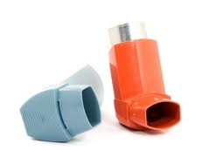
Treatment/Therapy
*No known cure
*Cannot be reversed
**Quit smoking**
Avoid second hand smoke
Inhalers-corticosteroids, bronchodilators
Assess/monitor daily, regular visits to physician/specialist
Cardiac Rehab
Vaccinate early for flu/pneumonia
Oxygen therapy
Surgery:
Bullectomy-removal of damaged air sacs
Lung volume reduction-removal of damaged lung tissue
Lung transplant

Slide 19
Natural Treatment?
Effects of Omega-3 Polyunsaturated Fatty Acids (PUFAs) on Inflammatory Markers in COPD
64 patients with COPD
2 different groups received 400 kcal/day of omega-3 supp.
Group of rich supp. And group of non-rich
RESULTS
Cytokine levels changed
Arterial oxygen when walking improved
Mild side effects
**Was considered by the Doctors involved to be a safe and practical, natural method for treating COPD.

Slide 20
Community Health Prevention Program
The COPD Learn More Breathe Better® campaign has gone country! Country Conquers COPD™, a program of the National Heart, Lung, and Blood Institute, brings important information about COPD to those most at risk. COPD (chronic obstructive pulmonary disease), the 3rd leading cause of death in the United States, affects 1 in 5 adults over the age of 45. That means you or someone you know could have COPD and not even know it. Millions do
Developed to raise awareness of COPD and encourage prevention and early detection for decreased incidence rates in the future.

Slide 21
References
Anda RF, Brown DW, Dube SR, Bremner JD, Felitti VJ, Giles WH. Adverse childhood experiences and chronic obstructive pulmonary disease in adults. Am J Prev Med 2008;34:396-403.
Bišanović S. The Length of Cigarette Smoking is the Principal Risk Factor for Developing COPD. International Journal of Collaborative Research on Internal Medicine & Public Health. 2012; 4(1):46-54.
Centers for Disease Control and Prevention. Smoking-attributable mortality, years of potential life lost, and productivity losses—United States, 2000-2004. Morbidity and Mortality Weekly Report 2008;57(45):1226-1228.
Centers for Disease Control and Prevention. Deaths from chronic obstructive pulmonary disease—United States, 2000-2005. Morbidity and Mortality Weekly Report 2008;57(45):1229-1232.
Friedlander A, MD.; Lundstromn, MA; Make, B, MD. Assessing The Effectiveness of “Making The Right Diagnosis: The Need for Spirometry”. Journal of Continuing Education in Health Professions, 2010. 30(1):72-73.
George, D; Halbert, RJ; Igbal, A; Isonaka, S. “Interpreting COPD prevalence estimates: Whatis is the True Burden of Diagnosis?”. CHEST, 2003; 123(5) 1684-92.
Global surveillance, prevention and control of chronic respiratory diseases : a comprehensive approach / Jean Bousquet and Nikolai , Khaltaev editors
WHO strategy for prevention and control of chronic respiratory diseases. Geneva,
World Health Organization, 2002 (http://whqlibdoc.who.int/hq/2002/WHO_MNC_CRA_ 02.1.pdf, accessed 8 Fecbruary 2007

